Slide 1
Road Safety
Crossing the road

Slide 2
Crossing roads
Find a safe place to cross
Stop before you get to the kerb
Look left and right, then left again
Wait, if traffic is passing
Look and listen again, when it is safe and there is no traffic, walk straight across the road
Do not run!
!! Click on the picture, to watch the video…

Slide 3
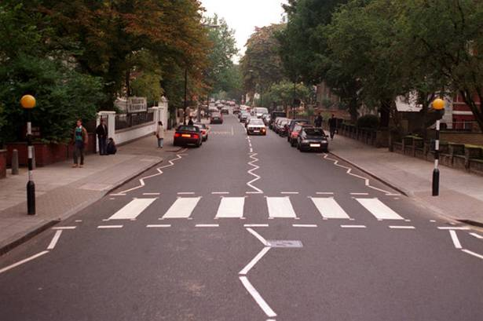
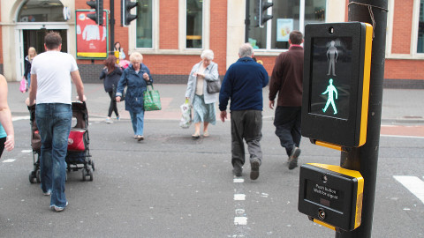
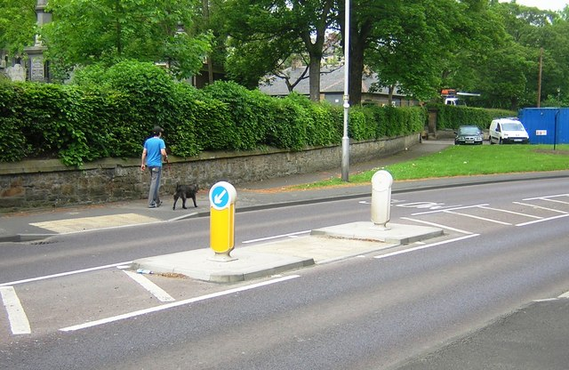
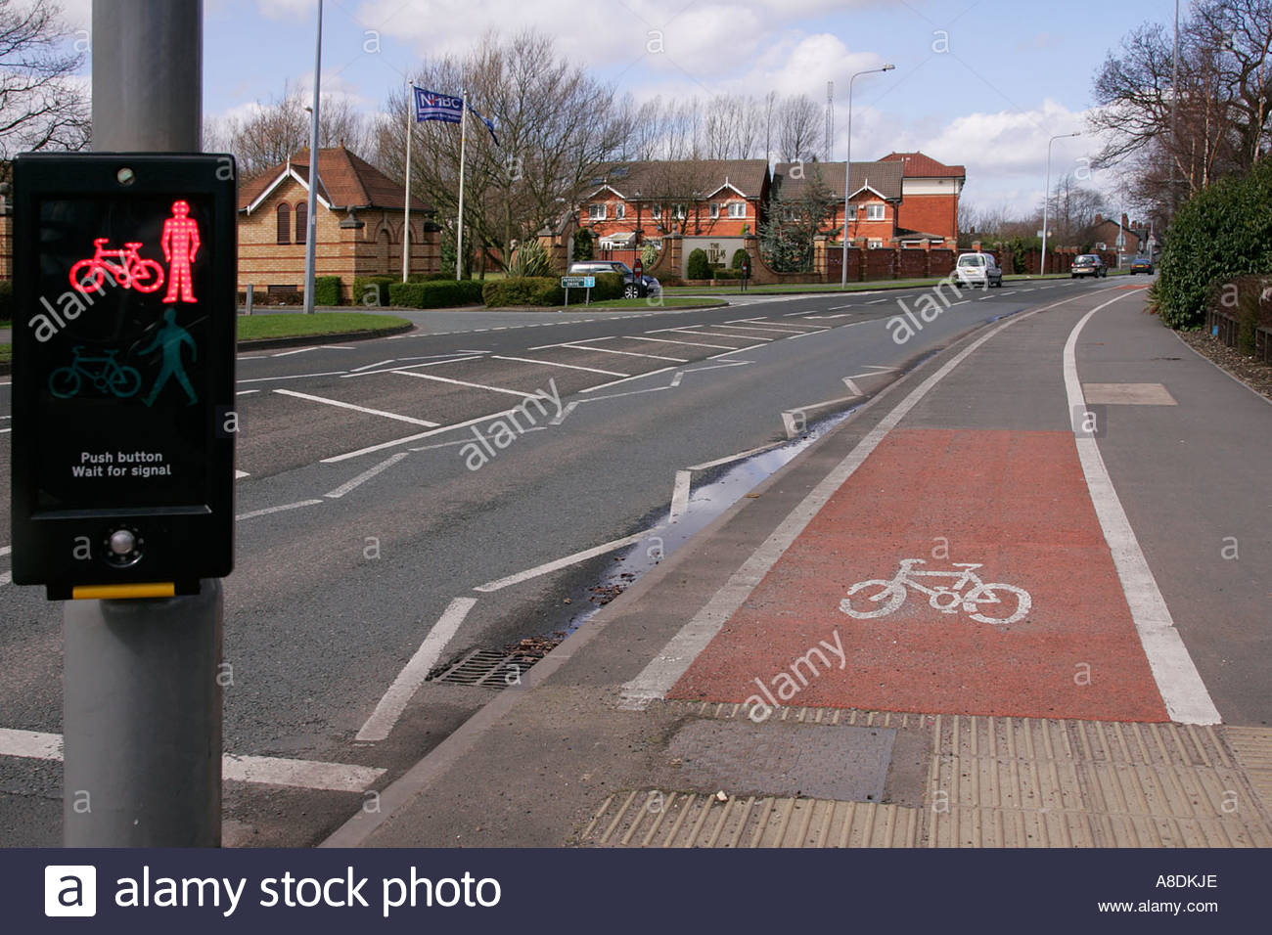
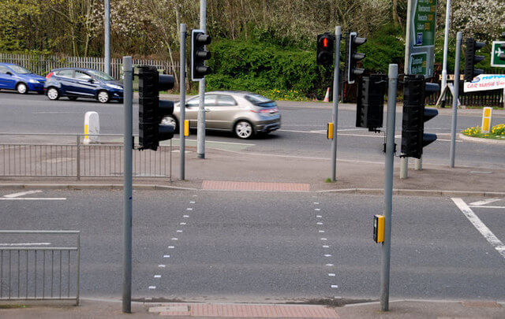
Safe Crossings
Zebra crossing
Traffic island
Pelican crossing
Puffin crossing
Toucan crossing

Slide 4
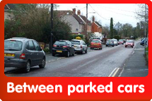
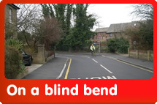
Never try to cross…

Slide 5
Crossing roads at traffic lights
Stop at the kerb
Press the button
Check the display on the traffic light, if the person is red you need to wait
When the person changes to green, you can now cross
Keep walking, keeping a watch for vehicles
Do not run!

