Slide 1
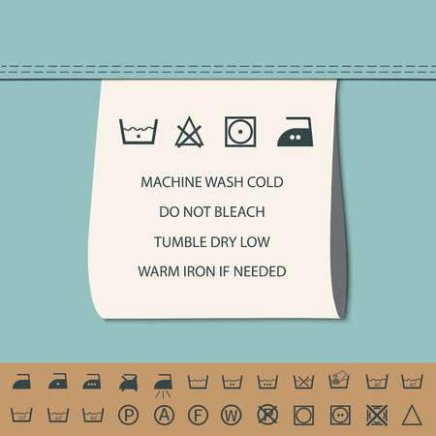
Care labels for ironing
polyester
Wool
Denim, cotton

Slide 2
Learning to Iron

Slide 3
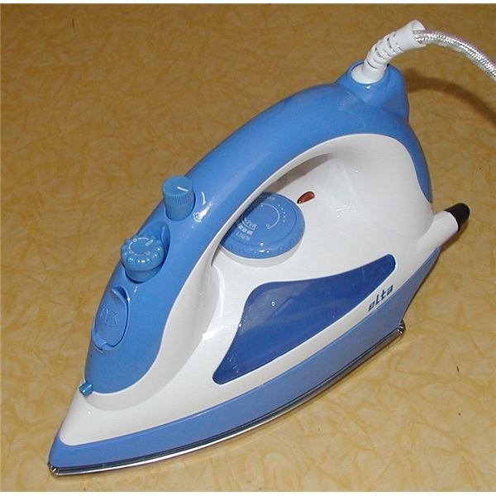
Parts of an iron
cord
light
water tank
temperature dial
plate

Slide 4
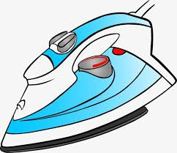
Top tips!
Make sure your ironing board is stable
Store the iron on the base
Be aware of trailing cable
Follow the clothing care label instructions carefully
Set the iron to the correct level for you clothes
Sort clothes into piles of linen, cotton and synthetics
Avoid ironing over the top of sharp objects like zips or buttons
When you finish ironing, turn off and unplug your iron
Let iron cool down before storing away.

Slide 5
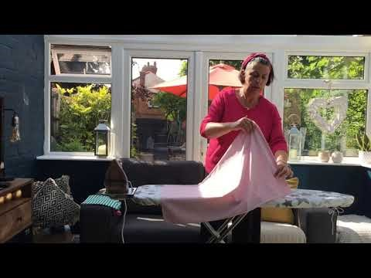
Download the video link below.

